Slide 1
Quarkonia and heavy-light mesons in a covariant quark model
Sofia Leitão
CFTP, University of Lisbon, Portugal
in collaboration with:
Alfred Stadler, M. T. Peña and Elmar P. Biernat
HUGS, JLab, USA June, 2015 Sofia Leitão

Slide 2
A unified model for all $q\overline{q}$ mesons
Much important work was done on meson structure:
Cornell-type potential models (Isgur and Godfrey, Spence and Vary, etc.)
But: nonrelativistic (or “relativized”); structure of constituent quark and relation to
existence of zero-mass pion in chiral limit not addressed
Dyson-Schwinger approach (C. Roberts et al.)
But: Euclidean space; only Lorentz vector confining interaction
Lattice QCD (also Euclidean space), EFT, Bethe-Salpeter, Light-front, Point-form, …
We have just learned about it :)
Our objectives:
Construct a model to describe all $q\overline{q}$-type mesons
Covariant framework (CST) - light quarks require relativistic treatment
Work in Minkowski space (physical momenta)
Quark self-energy from $q\overline{q}$ interaction kernel (consistent quark mass function)
Chiral symmetry: massless pion in chiral limit of vanishing bare quark mass
Calculate meson spectrum and bound state vertex functions (wave functions)
Pion elastic and transition form factors
Learn about confining interaction (scalar vs. vector, etc.)
HUGS, JLab, USA June, 2015 Sofia Leitão 2

Slide 3
CST main idea
interaction kernel
scattering amplitude
Example of the day
scattering problem
$$M$$
$$=$$
$$ν$$
$$+$$
$$ν$$
$$M$$
If kernel $𝒱=∑$ (all 1PI diagrams) $→$
exact result for $M$
Usual truncation: ladder approximation
How to truncate?
Cancelation theorem: $φ^{3}$- theory
[F.Gross, PR186, 1969]
2
[F.Gross, Relativistic Quantum Mechanics and Field Theory, 2004]
$$+$$
$$=$$
cancellation in all orders and exact in heavy-mass limit !
1
x
particle 1 on mass-shell: $k_{1}^{2}=m_{1}^{2}$
A “good way” to sum the contribution of all ladder + crossed ladder diagrams is to use the approximation of just 1 ladder diagram with the one particle on its mass-shell.
HUGS, JLab, USA June, 2015 Sofia Leitão 3

Slide 4
Covariant two-body bound-state equation
Start from the Bethe-Salpeter (BS) equation
$$Γ_{BS}\left(p,P\right)=i\int{\frac{d^{4}k}{{\left(2π\right)}^{4}}𝒱\left(p,k;P\right)S_{1}(k_{1})Γ_{BS}\left(k,P\right)S_{2}(k_{2})}$$
Back to $q\overline{q}$mesons!
$$S_{i}\left(k_{i}\right)=\frac{1}{m_{0i}−k_{i}+Σ_{i}\left(k_{i}\right)−iε }$$
$$Σ_{i}\left(k_{i}\right)=A_{i}\left(k_{i}^{2}\right)+{k_{i}B}_{i}(k_{i}^{2})$$
$$P=k_{1}−k_{2}$$
total momentum
$$k=k_{1}+k_{2}/2$$
relative momentum
$$Γ\left(k,P\right) or Γ(k_{1},k_{2})$$
vertex function
$$𝒱\left(p,k \right)$$
kernel
Kernel contains confining interaction + color Coulomb +/or constant
In the BS equation it is effectively iterated to all orders
But the complete kernel is a sum of an infinite number of irreducible diagrams
$→$ has to be truncated (most often: ladder approximation)
Now we take a closer look at the loop integration over $k_{0}$
HUGS, JLab, USA June, 2015 Sofia Leitão 4

Slide 5
From Bethe-Salpeter to CST
Covariant Spectator Theory (CST)
Mini-review: A.Stadler, F. Gross, Few-Body Syst. 49, 91 (2010)
Integration over relative energy $k_{0}$:
Keep only pole contributions from propagators
Cancellations between ladder and crossed ladder diagrams can occur
Reduction to 3D loop integrations, but covariant
Works very well in few-nucleon systems
If bound-state mass $μ$ is small:
both poles are close together (both important)
Symmetrize pole contributions from both half planes:
resulting equation is symmetric under charge conjugation
HUGS, JLab, USA June, 2015 Sofia Leitão 5

Slide 6
Four-channel CST equation
Closed set of equations when external legs are systematically placed on-shell
Approximations can be made for special cases:
mesons with different quark constituent masses: 2 channels
large bound-state mass: 1 channel
Nonrelativistic limit: Schrödinger equation
HUGS, JLab, USA June, 2015 Sofia Leitão 6

Slide 7
CST bound-state (cont.)
2CS
Dominant pole!
1CS
Why to study such an equation?
prepare and test the numerics
test already our phenomenological choice for
should be a good approach to large $μ$ systems:
$$𝒱$$
$$𝒱$$
Quarkonia ($Q\overline{Q})$ and heavy-light ($Q\overline{q})$
HUGS, JLab, USA June, 2015 Sofia Leitão 7

Slide 8
Interaction kernel
The 1CS eq. reads:
for now,
fixed masses
$$Γ_{1CS}\left(p,P\right)=−∫\frac{d^{3}k}{2E_{k_{1}}{\left(2π\right)}^{3}}𝒱\left(p,k;P\right)Λ_{1}\left({\hat{k}}_{1}\right)Γ_{1CS}\left(k,P\right)S_{2}\left(k_{2}\right),$$
$$S_{2}\left(k_{2}\right)=\frac{1}{m_{02}+Σ_{2}\left(k_{2}\right)−k_{2}+−iε},$$
Vertex function for a pseudoscalar meson:
$$m_{2}$$
$$Γ\left(p\right)=Γ_{1}\left(p\right)γ^{5}+Γ_{2}\left(p\right)γ^{5}\left(m_{2}−p_{2}\right),$$
the most general form for CST.
Interquark interaction (phenomenological)
$$𝒱\left(p,k\right)={σ V}_{L}\left(p,\hat{k}\right)\left[\left(1−y\right)𝕝_{1}⊗𝕝_{2}−y γ_{1}^{μ}⊗γ_{2}^{μ}\right] + {α V}_{OGE}\left(p,\hat{k}\right)γ_{1}^{μ}⊗γ_{2}^{μ} + C\frac{δ^{3}(p−k)}{2E_{k_{1}}}γ_{1}^{μ}⊗γ_{2}^{μ}$$
correct nonrelativictic limit for arbitrary $y$
Linear confinement
One-gluon-exchange (OGE)
Constant
$$V_{L}\left(p,\hat{k}\right)\left[\left(1−y\right)\left(𝕝_{1}⊗𝕝_{2}+γ_{1}^{5}⊗γ_{2}^{5}\right)−y γ_{1}^{μ}⊗γ_{2}^{μ}\right]$$
CST $ππ$- scattering studies - constraints - Lorentz structure
HUGS, JLab, USA June, 2015 Sofia Leitão 8

Slide 9
Linear confinement in momentum space
subtle detail
Nonrelativistic case
SL, A. Stadler, E. Biernat, M.T. Peña; PRD90, 096003 (2014)
$${\tilde{V}}_{L,ε}\left(r\right)=\frac{σ}{ε}\left(1−e^{−εr}\right)$$
equiv.
$${\tilde{V}}_{A,ε}\left(r\right)≡−\frac{σ}{ε}e^{−εr}$$
$${\tilde{V}}_{L}\left(r\right)=σr$$
${\tilde{V}}_{L,ε}\left(r\right)={\tilde{V}}_{A,ε}\left(r\right)−{\tilde{V}}_{A,ε}(0)$,
with
Fourier Transform
$$V_{L,ε}\left(p,k\right)=V_{A,ε}\left(q\right)−{\left(2π\right)}^{3}δ^{(3)}\left(q\right)∫\frac{d^{3}q′}{{\left(2π\right)}^{3}}{ V}_{A,ε}\left(q′\right)$$
$$V_{L}\left(p,k\right)=V_{A}\left(q\right)−{\left(2π\right)}^{3}δ^{\left(3\right)}\left(q\right)∫\frac{d^{3}q^{′}}{{\left(2π\right)}^{3}}{ V}_{A}\left(q^{′}\right),$$
lim $ε→0$
$$V_{A}\left(q\right)≡−\frac{8πσ}{q^{4}}$$
Relativistic case
$$V_{L}\left(p,\hat{k} \right)=V_{A}\left(p,\hat{k}\right)−2E_{p_{1}}{\left(2π\right)}^{3}δ^{\left(3\right)}\left(p−k\right)\int{\frac{d^{3}k′}{{\left(2π\right)}^{3}2E_{k1′}}{ V}_{A}\left({p,\hat{k}}^{′}\right)}$$
$$V_{A}\left(p,\hat{k}\right)=−\frac{8πσ}{{\left(p−\hat{k}\right)}^{4}}$$
Covariant;
$\int{\frac{d^{3}k}{2E_{k_{1}}}V_{L}\left(p,\hat{k}\right)=}0;$ necessary to prove chiral symmetry
nonrelativistic limit: $\lim_{ε→0}∫d^{3}k V_{L,ε}\left(p−k\right)ψ\left(k\right)= P∫\frac{d^{3}k}{{\left(p−k\right)}^{4}}\left(ψ\left(k\right)−ψ\left(p\right)\right)$
well-defined integral as a
Cauchy Principal Value integral
HUGS, JLab, USA June, 2015 Sofia Leitão 9

Slide 10
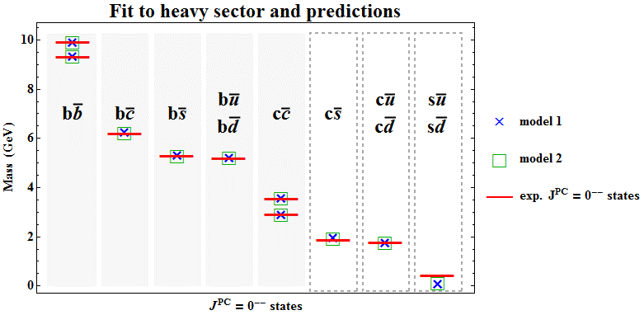
some results
Input:
$$m_{b}=4.7931$$
$$m_{c}=1.5300$$
$$m_{s}=0.4000$$
$$m_{u}=m_{d}=0.2580$$
$$Λ=1.7 \overline{m}$$
Free-parameters:
$$σ, α, C, y$$
Model 11
$$V_{L}\left(p,k\right)\left[\left(1−y\right)𝕝_{1}⊗𝕝_{2}−y γ_{1}^{μ}⊗γ_{2}^{μ}\right]$$
Model 2
$$V_{L}\left(p,k\right)\left[\left(1−y\right)\left(𝕝_{1}⊗𝕝_{2}+γ_{1}^{5}⊗γ_{2}^{5}\right)−y γ_{1}^{μ}⊗γ_{2}^{μ}\right]$$
HUGS, JLab, USA June, 2015 Sofia Leitão 10

Slide 11
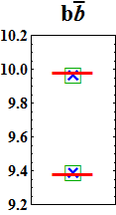
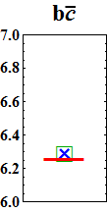
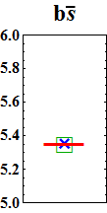
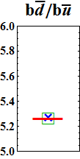
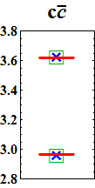
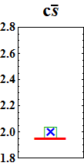
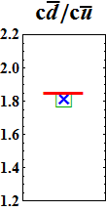
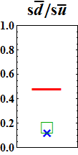
1CSE fit to quarkonia and heavy-light pseudoscalar states
Model 11
$$σ=0.22 GeV^{2}, α=0.38, C=0.337GeV, y=8.60×{10}^{−7}$$
Model 2
$$σ=0.21 GeV^{2}, α=0.37, C=0.311 GeV, y=0.38×{10}^{−7}$$
the linear confining interaction is compatible with $y=0$
$→$ suggests vector component suppressed
not very sensitive to the choice scalar vs scalar-plus-pseudoscalar structure
for systems with larger $μ$ the predictions are worse
$→$can be explained by the pole behavior
HUGS, JLab, USA June, 2015 Sofia Leitão 11
1CS is no longer a good approximation!
$$P=(μ,0)$$

Slide 12
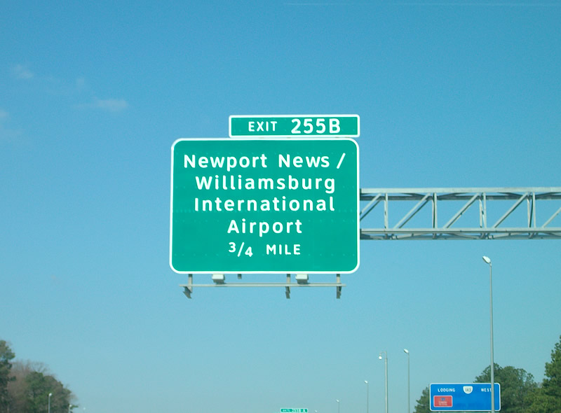
Summary and Outlook
We have solved the 1CS equation
Based on these early results, we can already state that:
CST is a promising covariant, Minkowski space approach to study the mesonic also
the bound-state problem.
soon, we hope!
Extend the fit to all other mesons (vector mesons, etc...)
Remake the ﬁts using full, self-consistent $q\overline{q}$ 1CS $m_{2}→{M_{2}\left(k^{2}\right)=m}_{02}+Σ_{2}\left(k_{2}\right)$
Solve the 2CS and 4CS using the numerical techniques developed – light sector (pion)
Recalculate the pion form factor
Calculate quark-photon vertex dynamically
E. Biernat, F. Gross, M.T. Peña, A. Stadler, PRD89, 016005 (2014), PRD89, 016006 (2014)
HUGS, JLab, USA June, 2015 Sofia Leitão 12

Slide 13
Backup slides

Slide 14
Subtraction Technique
Kernel in momentum space - singularities both in linear and OGE pieces
First treatment in the nonrelativistic limit because singularities have the same nature
Example
Nonrelativistic, unscreened limit of 1CSE with just a linear potential:
s-wave
$$\frac{p^{2}}{2m_{R}}ψ_{ℓm }\left(p\right)+𝒫∫dk\frac{k^{2}}{{\left(2π\right)}^{3}}\left[\left\langle pℓm | V_{A} | kℓm\right\rangle ψ_{ℓm }\left(k\right)−\left\langle p00 | V_{A} | k00\right\rangle ψ_{ℓm }\left(p\right)\right]=Eψ_{ℓm }\left(p\right)$$
$$\left\langle pℓm | V_{A} | kℓm\right\rangle =2π(−8πσ)\left[\frac{2P_{ℓ}(y)}{{\left(p^{2}−k^{2}\right)}^{2}}−\frac{{P^{′}}_{ℓ}\left(y\right)}{{\left(2p k\right)}^{2}}ln{\left(\frac{p+k}{p−k}\right)}^{2}+\frac{2w_{ℓ−1}^{′}(y)}{{\left(2pk\right)}^{2}}\right]$$
$$y=\frac{p^{2}+k^{2}}{2pk}$$
$$w_{ℓ−1}^{′}\left(y\right)=\sum_{m=1}^{ℓ}{\frac{1}{m}P_{ℓ−m}\left(y\right)P_{m−1}(y)}$$
2
1
singularities
$$p=k$$
For $ℓ>1:$
$$𝒫\int_{0}^{∞}{dk\frac{Q_{0}(y)}{k}=\frac{π^{2}}{2} \text{,}}$$
Add and subtract a term proportional to
Spence, Vary, PRD35, 2191 (1987)
Gross, Milana, PRD43, 2401 (1991)
Maung, Kahana, Norbury, PRD47,1182 (1993)
1
we can get rid of the logarithmic singularity.
HUGS, JLab, USA June, 2015 Sofia Leitão

Slide 15
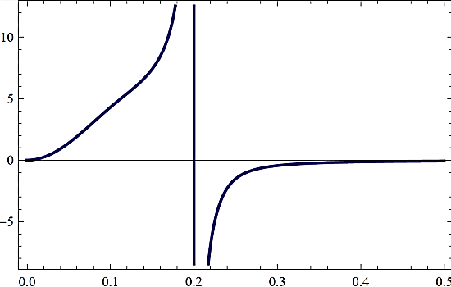
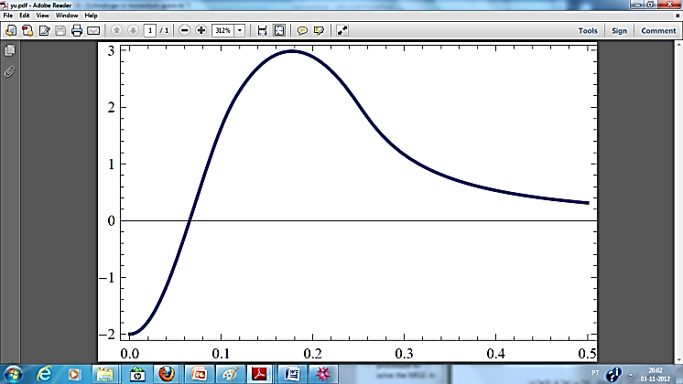
$$𝒫\int_{0}^{∞}{\frac{dk}{k^{2}−p^{2}}=0\text{,} }$$
2
Apply now a second subtraction based on we
New technique
can also remove the principal value singularity.
SL, A.Stadler, E.Biernat, M.T. Peña;
PRD90, 096003 (2014)
Singularity-free two-body equation
Before subtraction
After subtraction
Cubic B-splines
More stable results than the un-subtracted version for any partial wave;
Less computational time
Back to the 1CSE: This technique was very important for stability purposes!
All singularities are
eliminated from the
kernel!
HUGS, JLab, USA June, 2015 Sofia Leitão

Slide 16
Heavy-light scenario
With retardation we need to include a Pauli-Villars regularization, cut-off $Λ$
$$m_{1}=5 m_{1}$$
$$m_{2}=0.325 GeV$$
$$Λ=3.0 GeV$$
Light-light scenario
$$m_{1}=0.325 GeV$$
$$m_{2}=0.325 GeV$$
$$Λ=3.0 GeV$$
without retardation
with retardation
without retardation
Heavy-heavy scenario
with retardation
$$m_{1}=4.8 GeV$$
$$m_{2}=4.8 GeV$$
$$Λ=10.0 GeV$$
$q\overline{q}$ light: large retardation effects
nonrelativistic limit: retardation vanishes
without retardation
with retardation
HUGS, JLab, USA June, 2015 Sofia Leitão

Slide 17
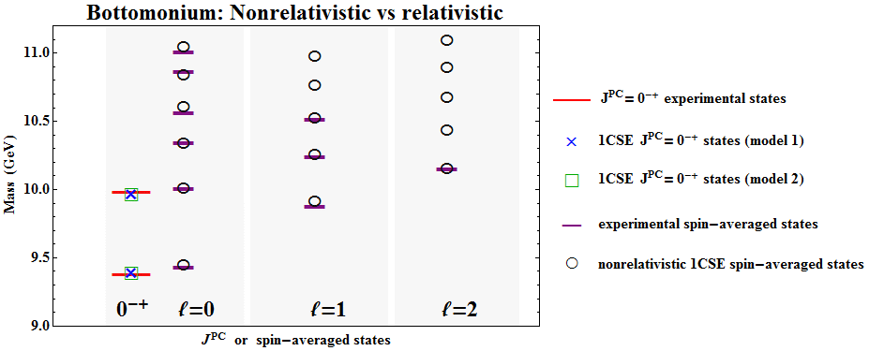
PRELIMINARY
SL, A.Stadler, E.Biernat, M.T. Peña; Phys. Rev. D90, 096003 (2014)
NR 1CSE
$$σ=0.167 GeV^{2}, α=0.5167, C=0.0 GeV, m_{b}=4.7931GeV$$
Model 11
$$σ=0.22 GeV^{2}, α=0.38, C=0.337GeV, y=8.60×{10}^{−7}$$
Model 2
$$σ=0.21 GeV^{2}, α=0.37, C=0.311 GeV, y=0.38×{10}^{−7}$$
HUGS, JLab, USA June, 2015 Sofia Leitão

Slide 18
First energy state (positive component)
1CSE Results
$$ψ_{1−}(p)$$
$$E_{1+}=0.9387 GeV$$
$$ψ_{1+}(p)$$
First energy state (negative component)
$$ψ_{1+}(p)$$
$$E_{1−}=−0.9363 GeV$$
$$ψ_{1−}(p)$$
Parameters used:
(linear piece)
Perfect agreement with previous results – faster convergence
(pure scalar)
$$y=0$$
$$σ=0.2GeV^{2}$$
$$m_{2}=0.325 GeV$$
$m_{1}/{ m}_{2}$=5
M. Uzzo, F. Gross, PRC59, 1009 (1999)
HUGS, JLab, USA June, 2015 Sofia Leitão

